Slide 1

Session 08
Introduction to Crystal Reports

Slide 2
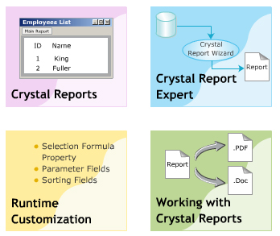
Objectives
Crystal Reports
Crystal Report Expert
Runtime Customization
Working with Crystal Reports
Formatting data
Expression field in report
Aggregate in report
Grouping in report
Load reports in one Form.
Other…

Slide 3
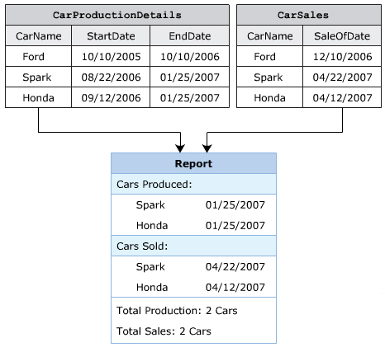
Introduction to Crystal Reports

Slide 4
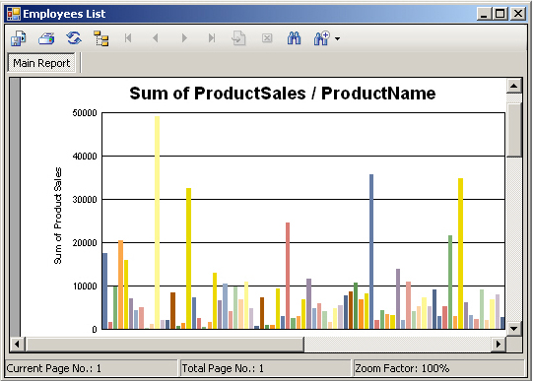
Uses of Crystal Report
Crystal Reports is a reporting tool that allows you to summarize a variety of data by generating interactive reports.
Advantages
Simplifies the process of analyzing data by generation of graphs.
Accelerates the process of computing complex calculation.
Display data easily based on the search criteria.
Displays data easily using various charts and graphs.
Formats data easily.

Slide 5
Features of Crystal Report
Data Access
Runtime Customization
Interaction between Report Viewer and Other Controls
Reports as Web Services
Reusability
Security

Slide 6
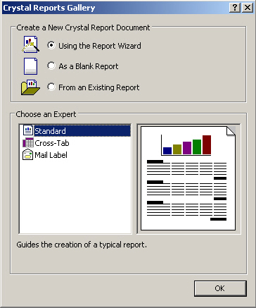
Crystal Report Creation Wizard
Standard
Cross-Tab
Mail Label

Slide 7
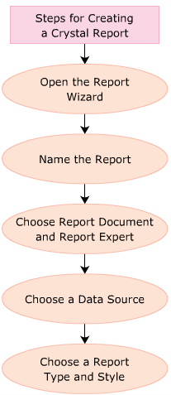
Steps for Creating Report

Slide 8
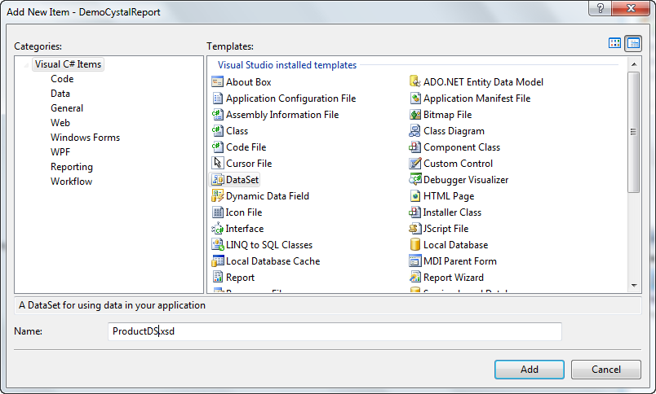
Creating Report Using ADO.NET
Step 1: Create and instance of a DataSet, which contains only the description of data and not the actual data.

Slide 9
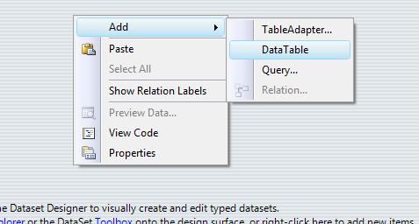
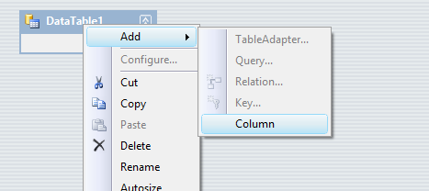
Add a DataTable to DataSet
Add column to datatable

Slide 10
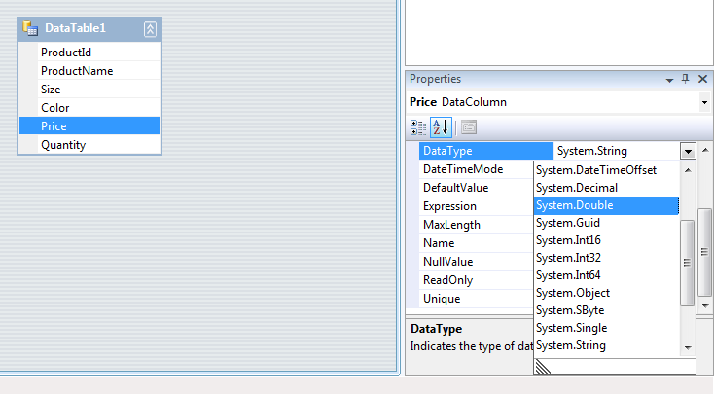
Choose data type for columns

Slide 11
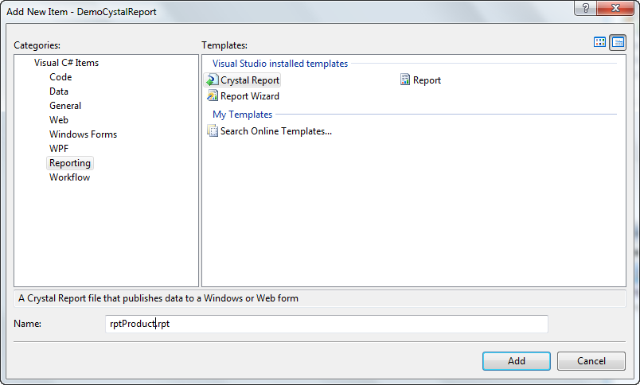
Add a CrystalReport to App

Slide 12
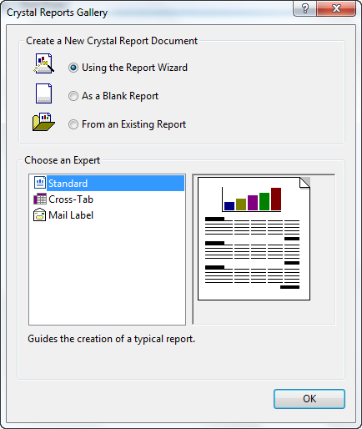
Choose Standard report

Slide 13
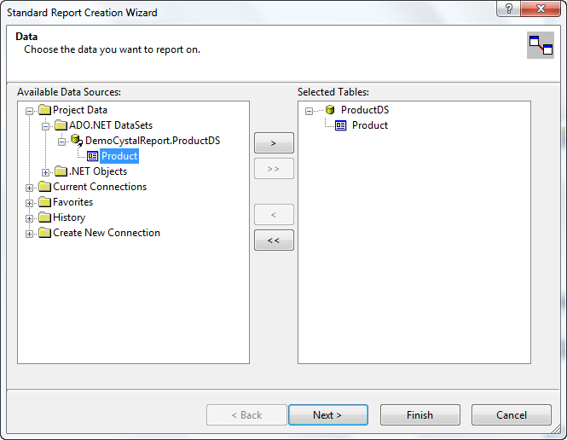
Choose datasource for report

Slide 14
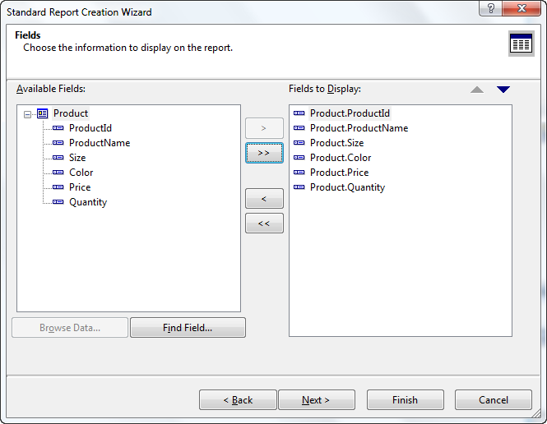
Choose fields for report

Slide 15
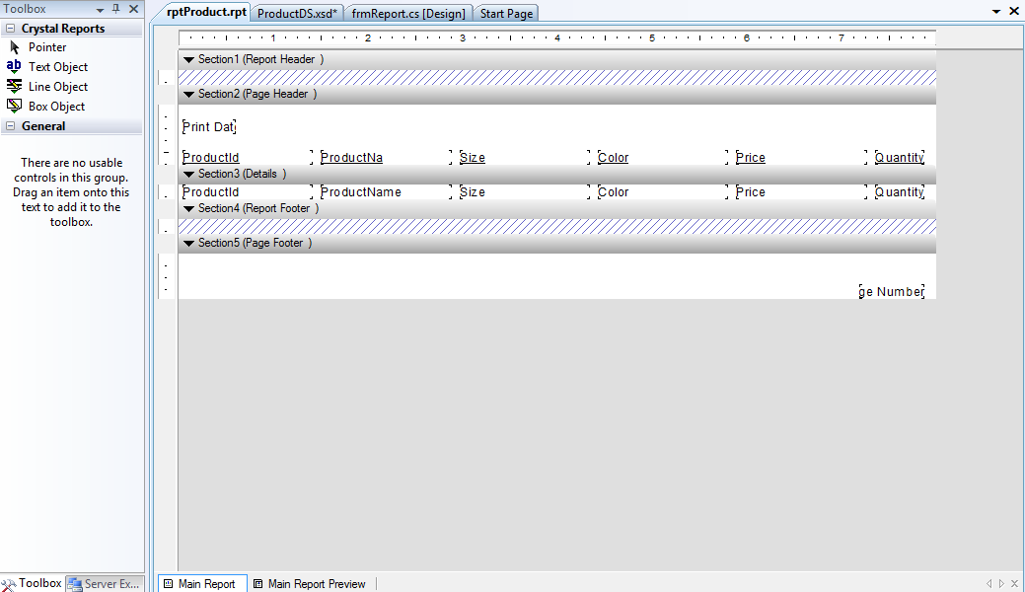
Click finish to generate report

Slide 16
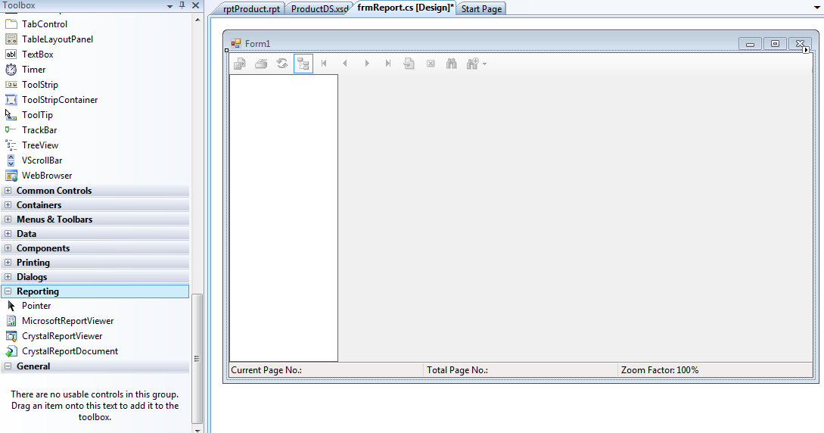
Binding Reports to Application
WF allows you to bind reports to the application by using CystalReportViewer control.

Slide 17
Code in Form_Load
string sqlconnect = "server=chungld;database=Shop;uid=sa;pwd=123465";
private void frmReport_Load(object sender, EventArgs e)
{
SqlDataAdapter da = new SqlDataAdapter("select productid,productname,size,color,price,quantity from product", sqlconnect);
DataSet ds = new DataSet();
da.Fill(ds);
rptProduct product = new rptProduct();
product.SetDataSource(ds.Tables[0]);
rptViewer.ReportSource = product;
rptViewer.Show();
}

Slide 18
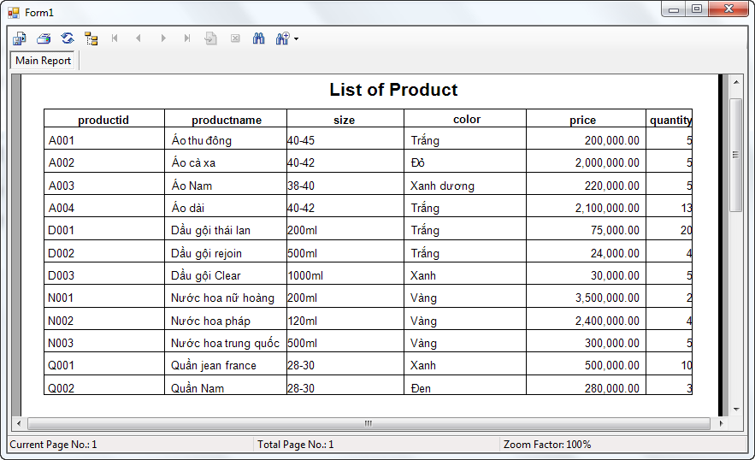
Build and Run

Slide 19
Customizing a Report at Runtime
You can customize a report at runtime in WF. This is done by adding the required code to the application using the Report Engine Object Model or by using the class for the WF Viewer.

Slide 20
“SelectionFormula” Property
You can use the selection formulas to filter and display the required records in a report. A selection formula can also be used in grouping and sorting fields of a table displayed in the report.
View product with name=Crazy but color not Red
rptViewer.SelectionFormula = "{Product.ProductName}=\"Crazy\" and {Product.Color}<>\"Red\"";

Slide 21
Parameter Fields
A parameter is like getting an answer to a question, from the user, without which the report will not be generated. To take values form the user at runtime, parameter fields are created programmatically.
Purposes of parameters
Passing a parameter on a database field allows the user to specify values for that field to filter the records.
Applying conditional formatting to the fields in reports, which the user has specified.
Specifying the order and the field name according to which data is sorted.
Grouping the required fields, which the user has specified.

Slide 22
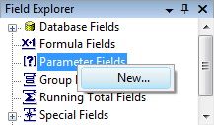
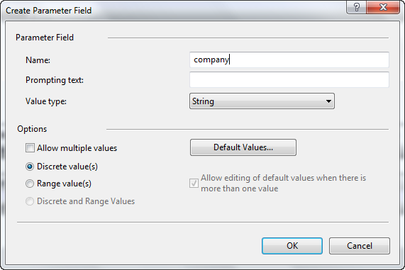
Creating parameter field

Slide 23
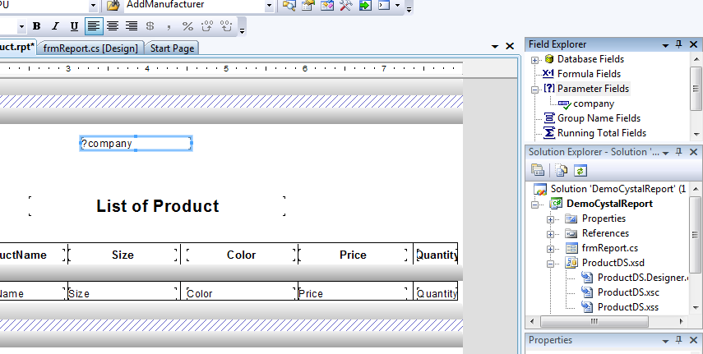
Creating parameter field

Slide 24
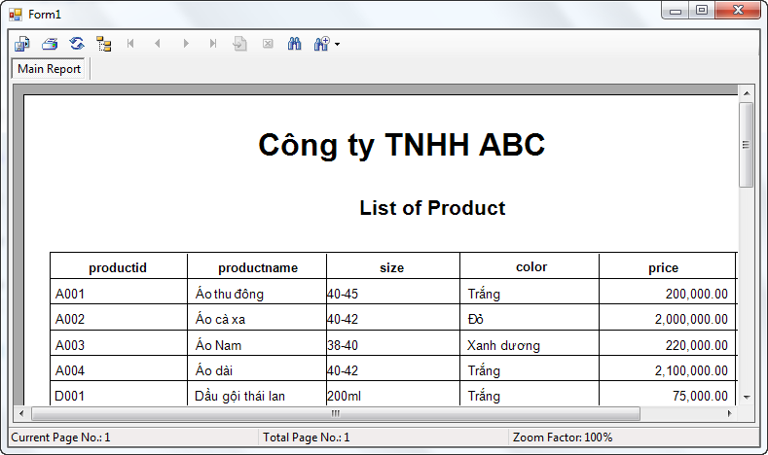
Pass value for parameter
rptproduct.SetParameterValue("company", "Công ty TNHH ABC");

Slide 25
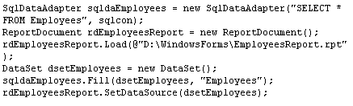
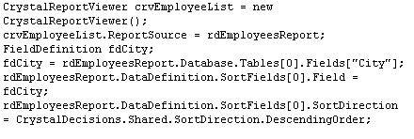
Sorting Fields at Runtime

Slide 26
Export a Report
Adobe Acrobat(.pdf)
Crystal Reports for Visual Studio .NET (.rpt)
HTML 3.2 and 4.0 (.html)
Microsoft Excel (.xls)
Microsoft Rich Text (.rtf)
Microsoft Word (.doc)

Slide 27
Operations in Crystal Report
Formatting data
Expression field in report
Aggregate in report
Grouping in report
Load reports in one Form.
Other…

Slide 28
Summary and Workshop
Crystal Reports
Crystal Report Expert
Runtime Customization
Working with Crystal Reports
Formatting data
Expression field in report
Aggregate in report
Grouping in report
Load reports in one Form.
Other…

Slide 29

THANKS FOR WATCHING !

